Slide 1

Brinbane HelpDesk
Team member:
Lim Jee
Jaideep Singh
Yingjie Jiang
Yuchen Zhao
Zejin Du
Wenbo Shi

Slide 2
Purpose
By setting a helpful platform, we can solve more daily problems about users.
Increase efficiency, users don’t need to worry about how to find a good service provider.

Slide 3
Achievement
After 4 Sprint Plan we finally achieved all basic functions in our website.
User can easily submit request for help.
Staff can easily assign works and check request status.

Slide 4
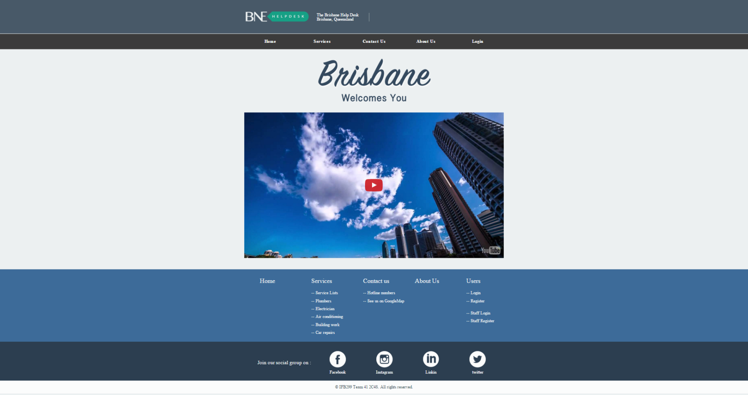
Sprint 1: Story S35 ‘Website Layout’

Slide 5
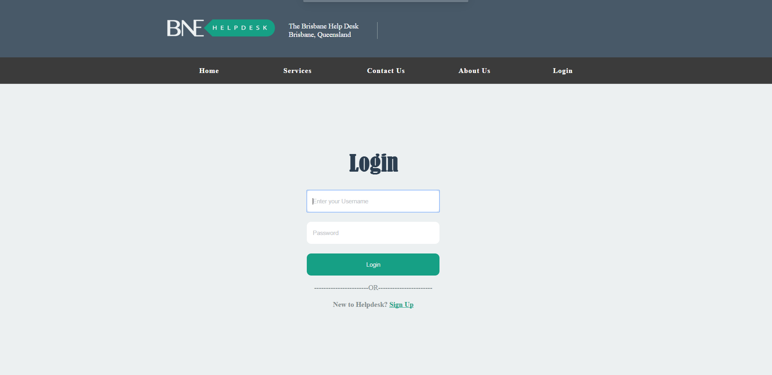
Sprint 1: Story S32 ‘Login & Logout’
This is the user login page

Slide 6
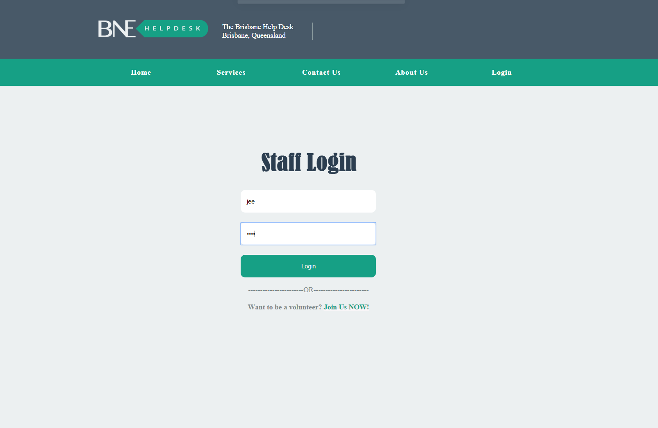
This is the staff login page

Slide 7
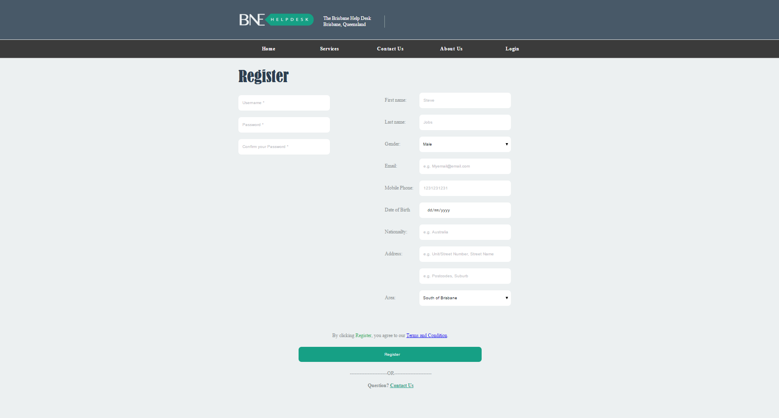
Sprint 1: Story S34 ‘Register pages’

Slide 8
Sprint 2: Story S02 ‘Staff registration form’

Slide 9
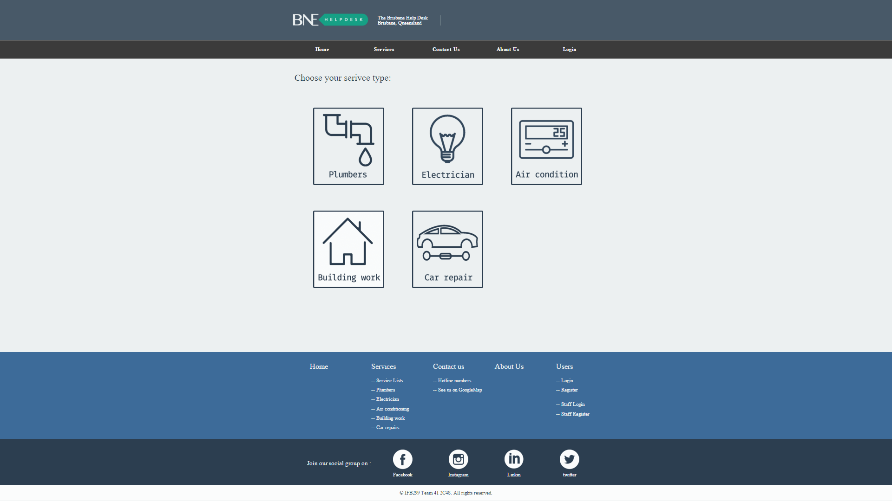
Sprint 2: Story S40 ‘Service information’

Slide 10
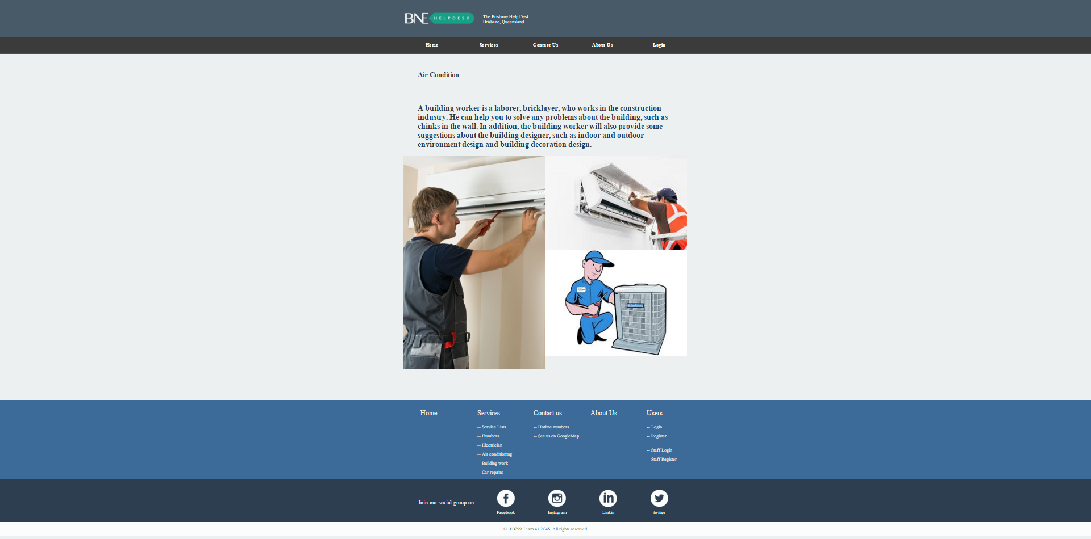

Slide 11
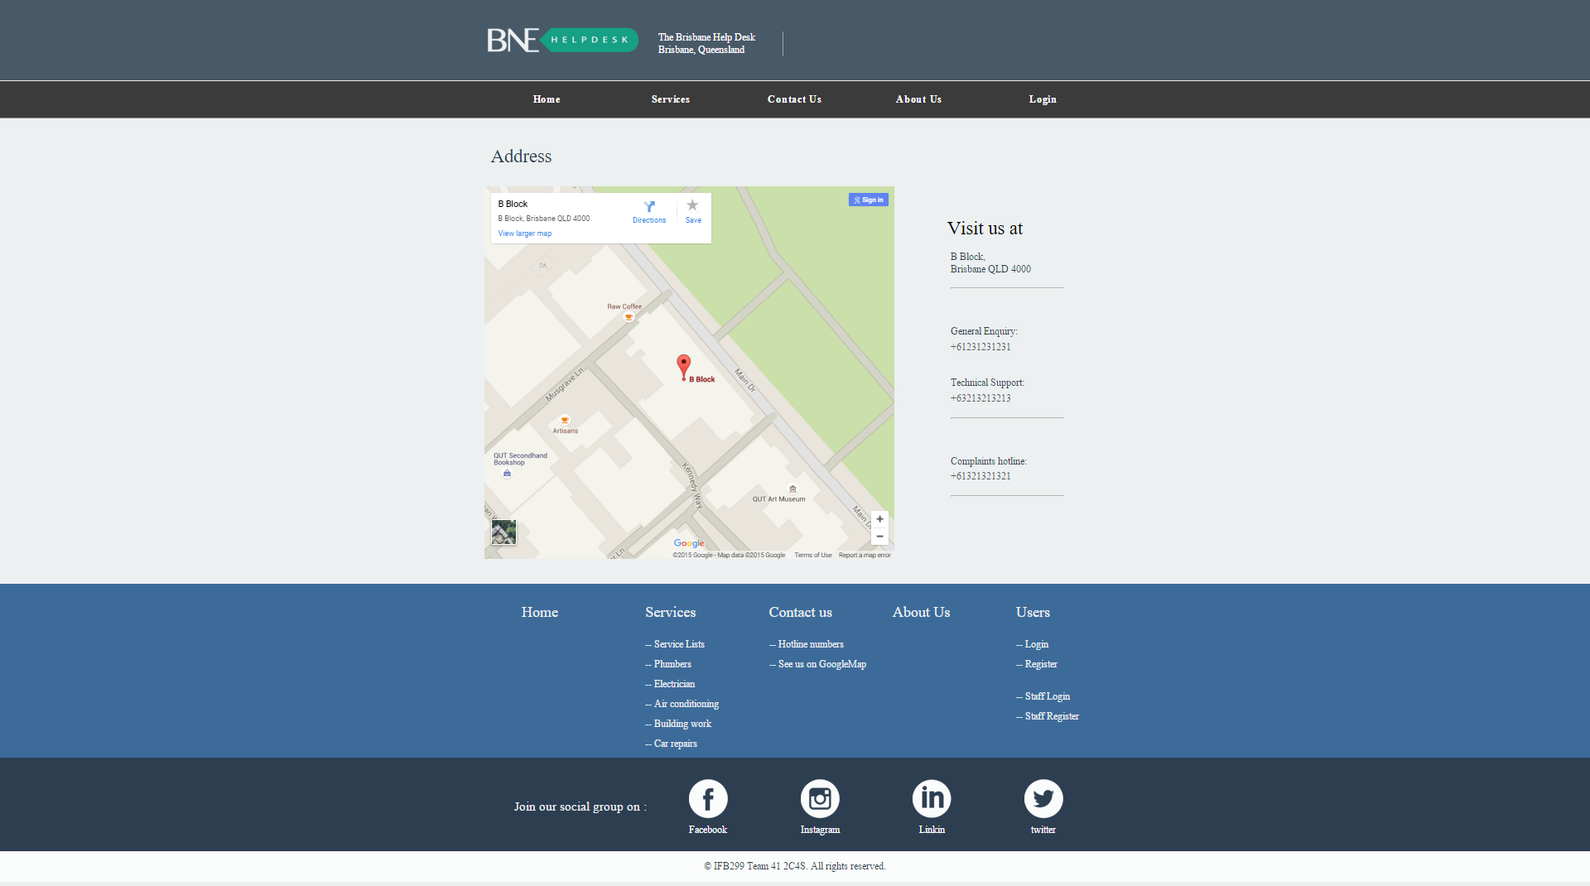
Sprint 2: Story S28 ‘Contact us’

Slide 12
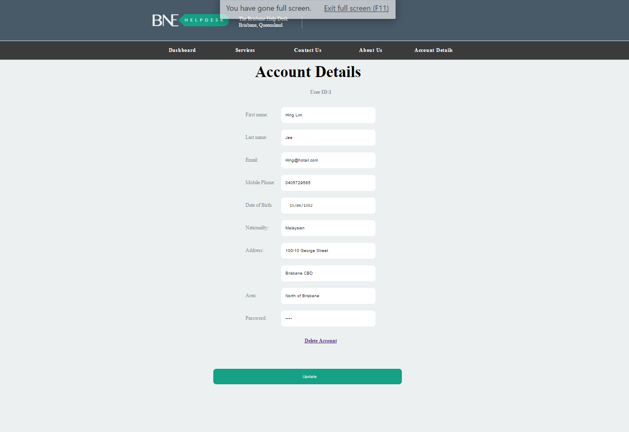
Sprint 2: Story S14 ‘User can update personal details’

Slide 13
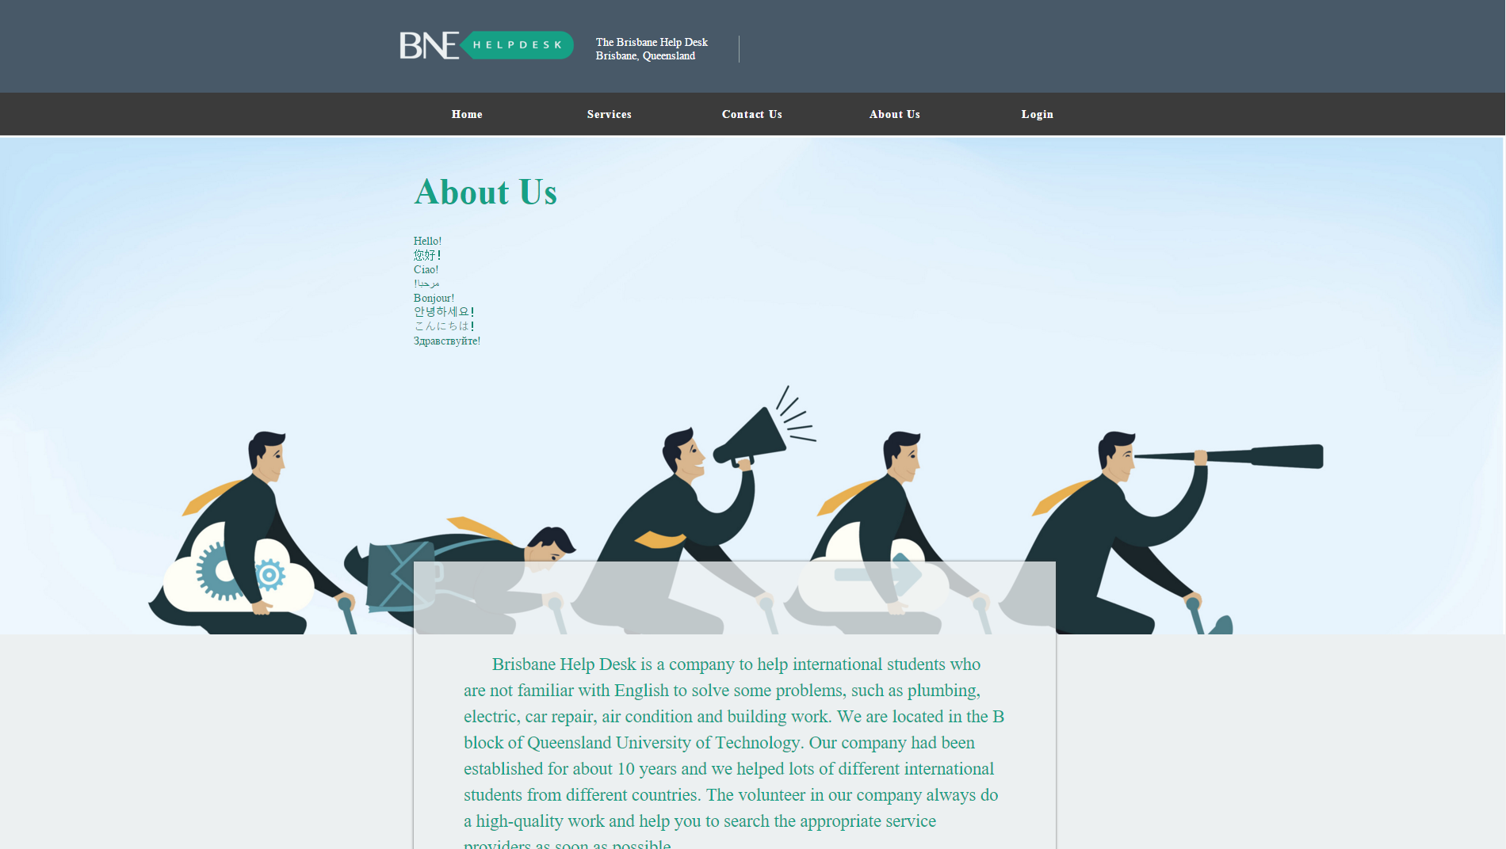
Sprint 2: Story S26 ‘About us’

Slide 14
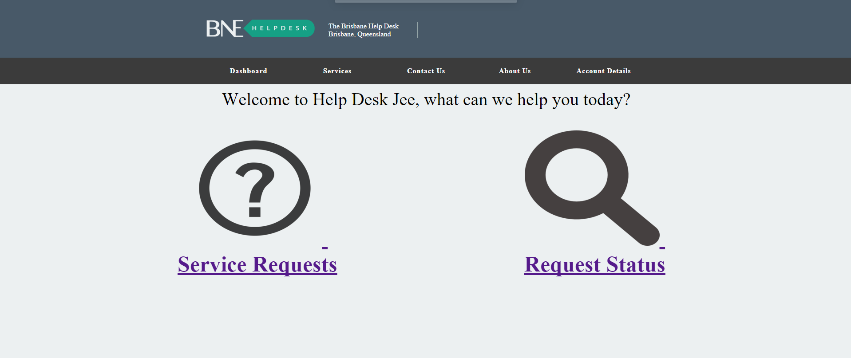
Sprint 2: Story S54 ‘Check Request Status’

Slide 15
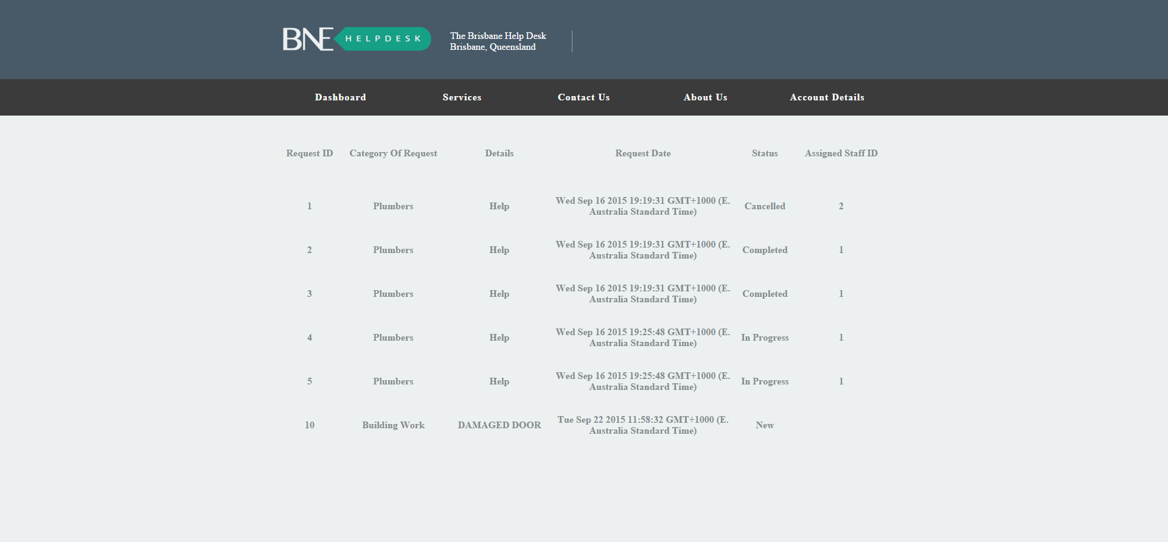

Slide 16
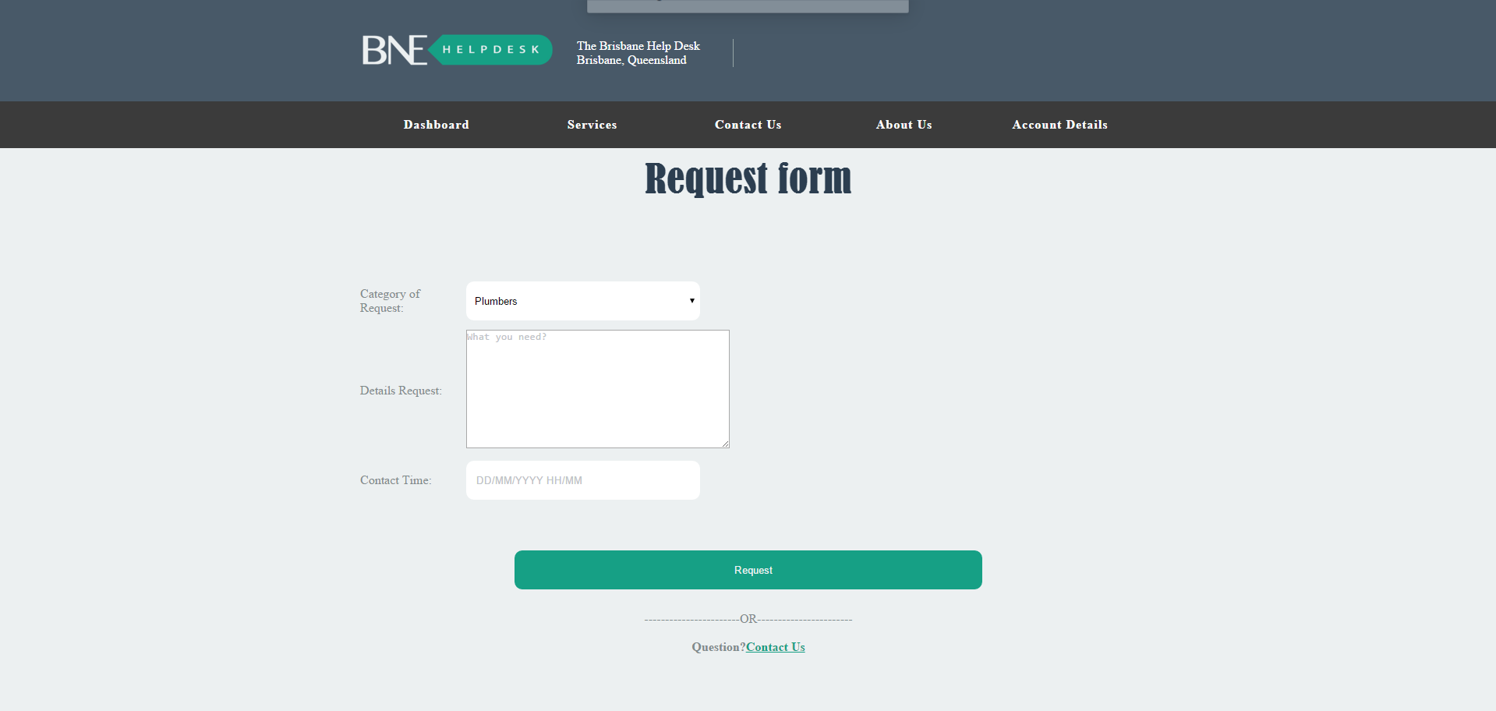
Sprint 2: Story S55 ‘Request Form’

Slide 17
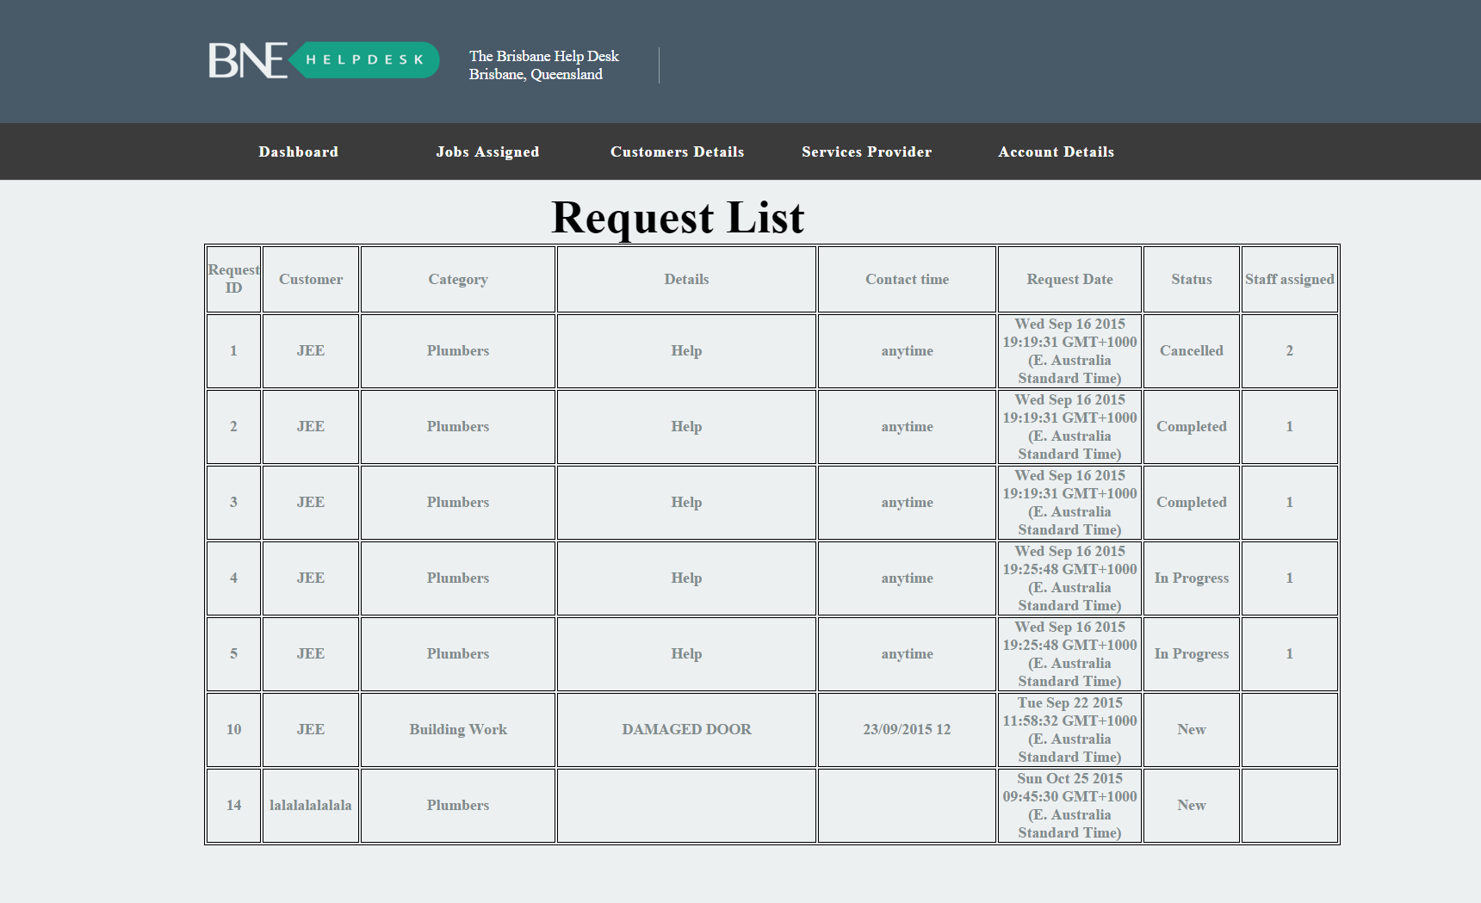
Sprint 3: Story S08 ‘Staff view request list’

Slide 18
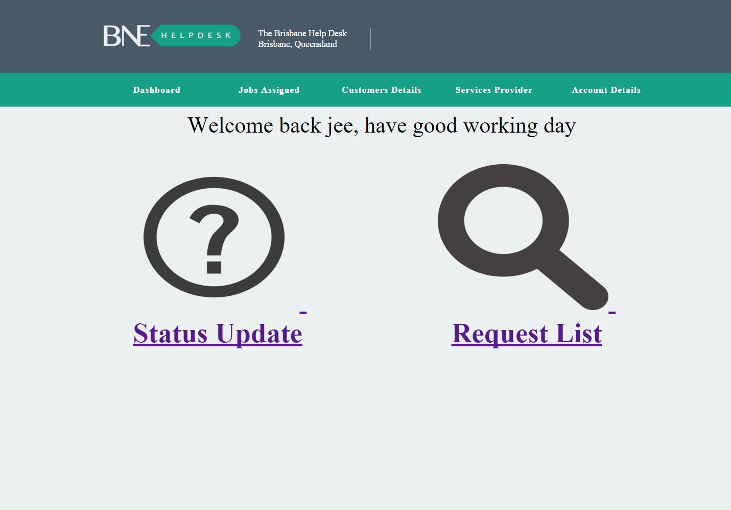
Sprint 3: Story S09 ‘Staff update status of issues’

Slide 19
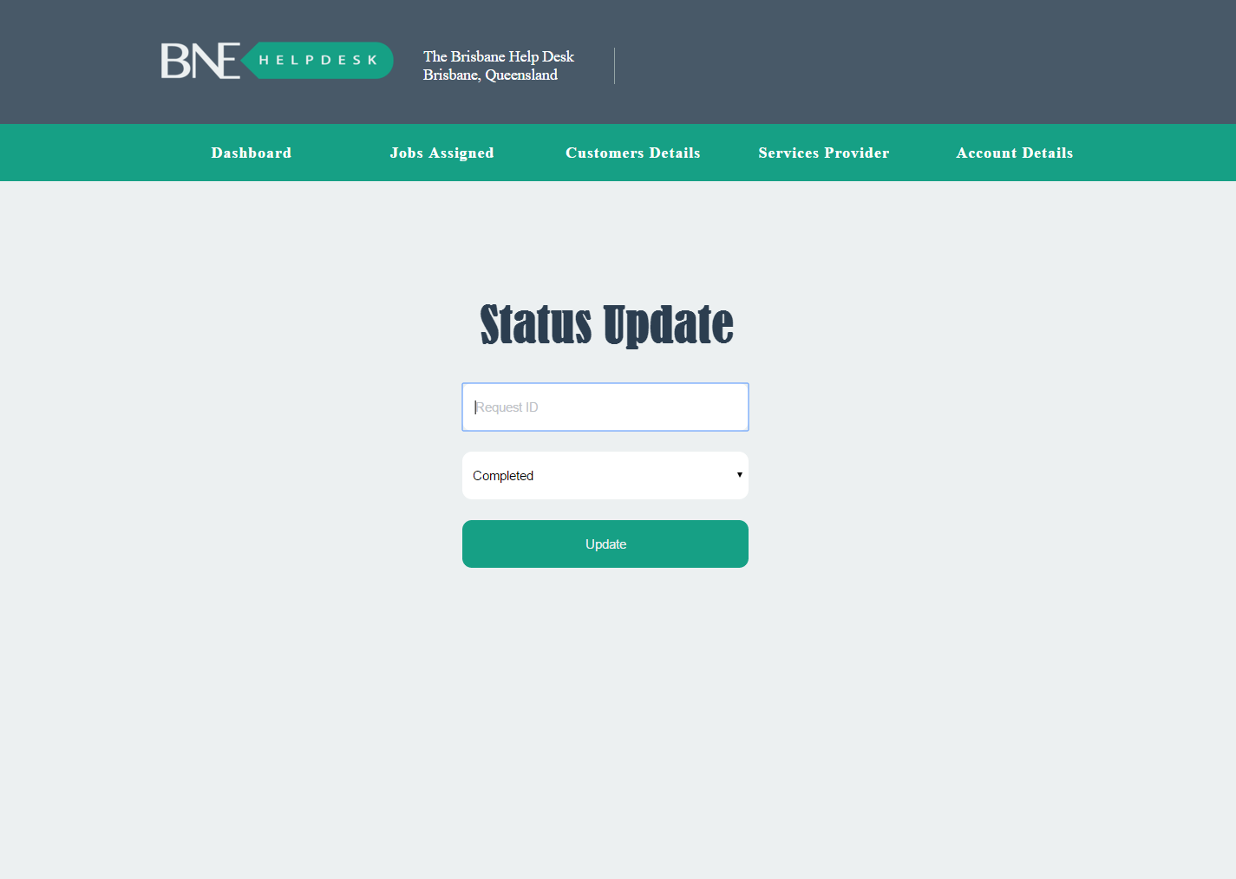

Slide 20
Sprint 3: Story S31 ‘Sending service request’

Slide 22
Sprint 4: Story S24 ‘User can read terms and condition’

Slide 23
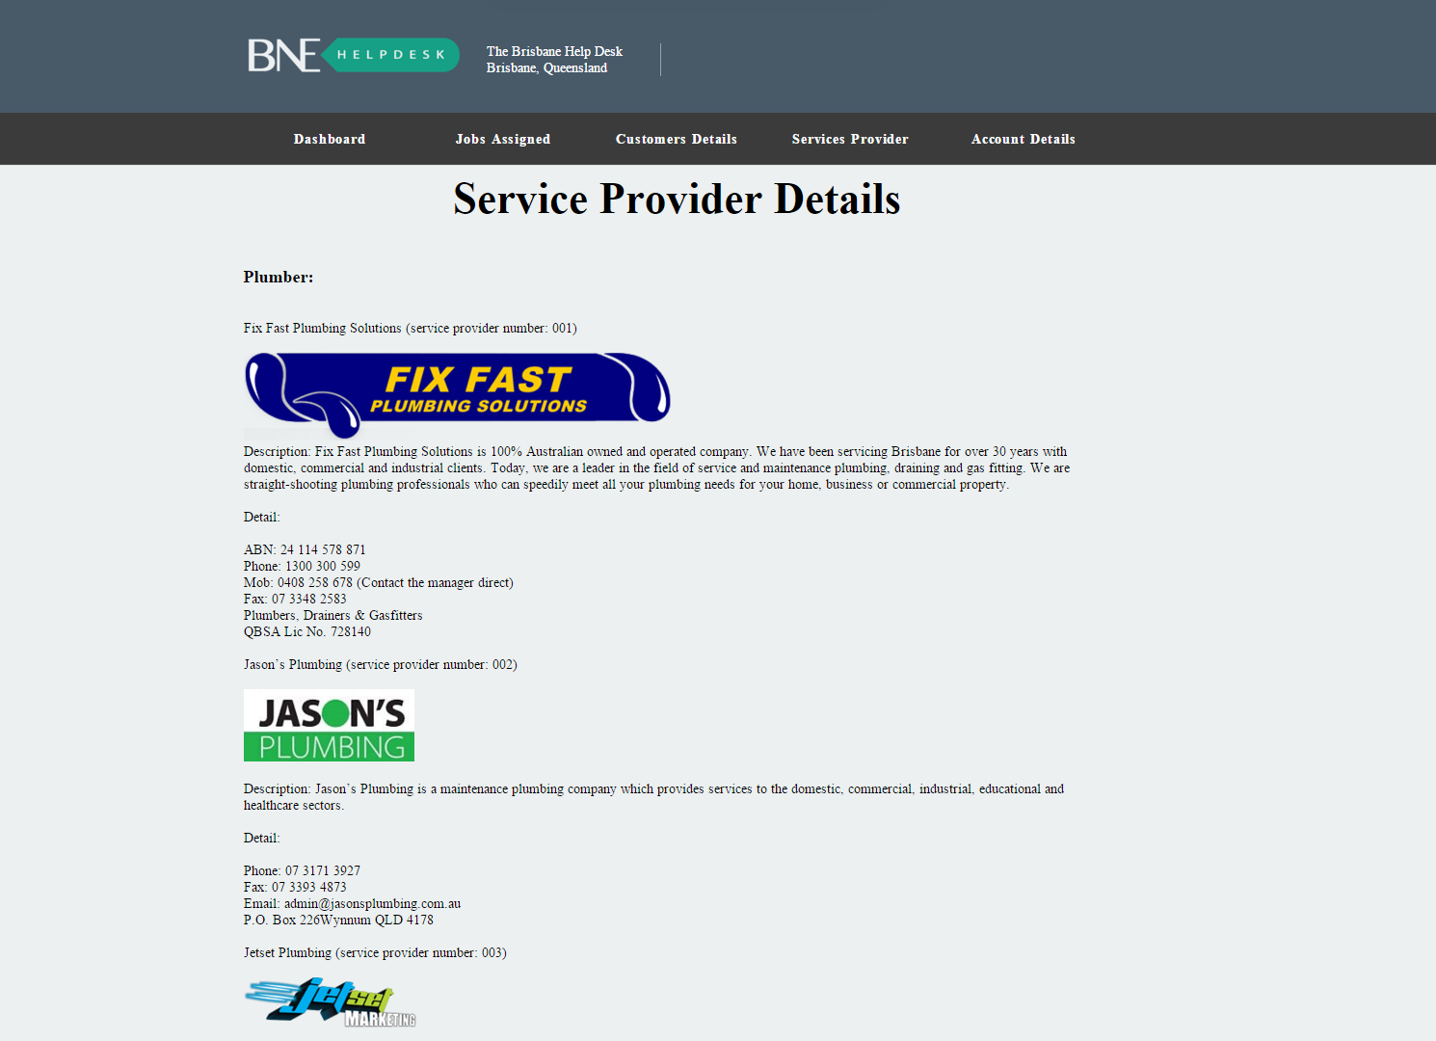
Sprint 4: Story S38 ‘Staff can see detail information of service provider’

Slide 24
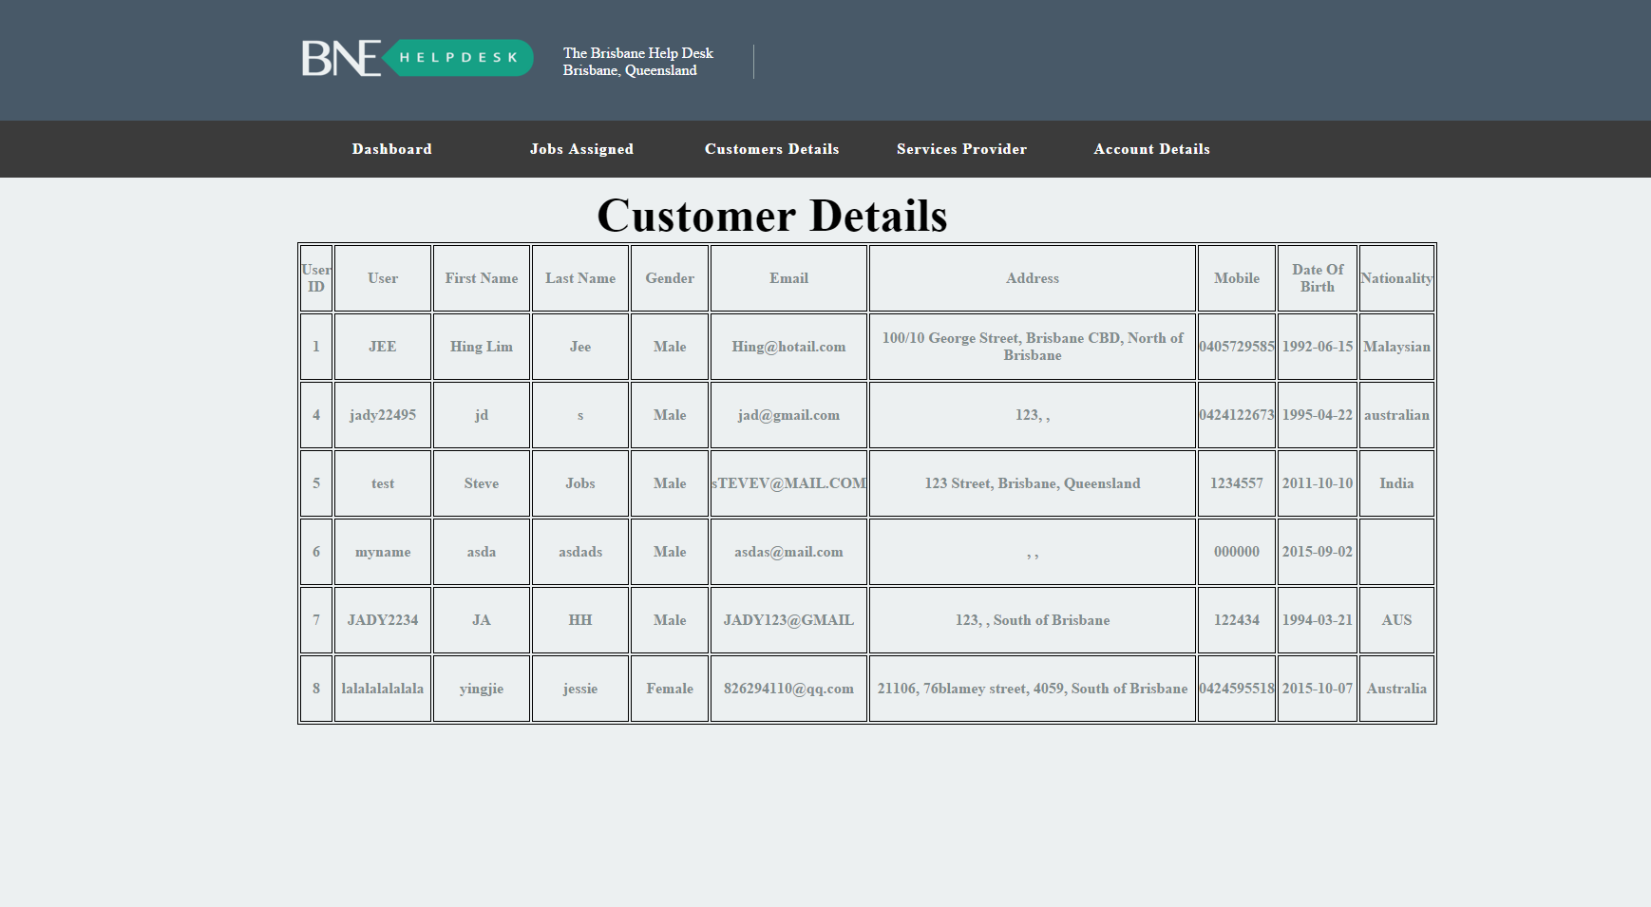
Sprint 4: Story S38 ‘Provide user’s phone number’

Slide 25
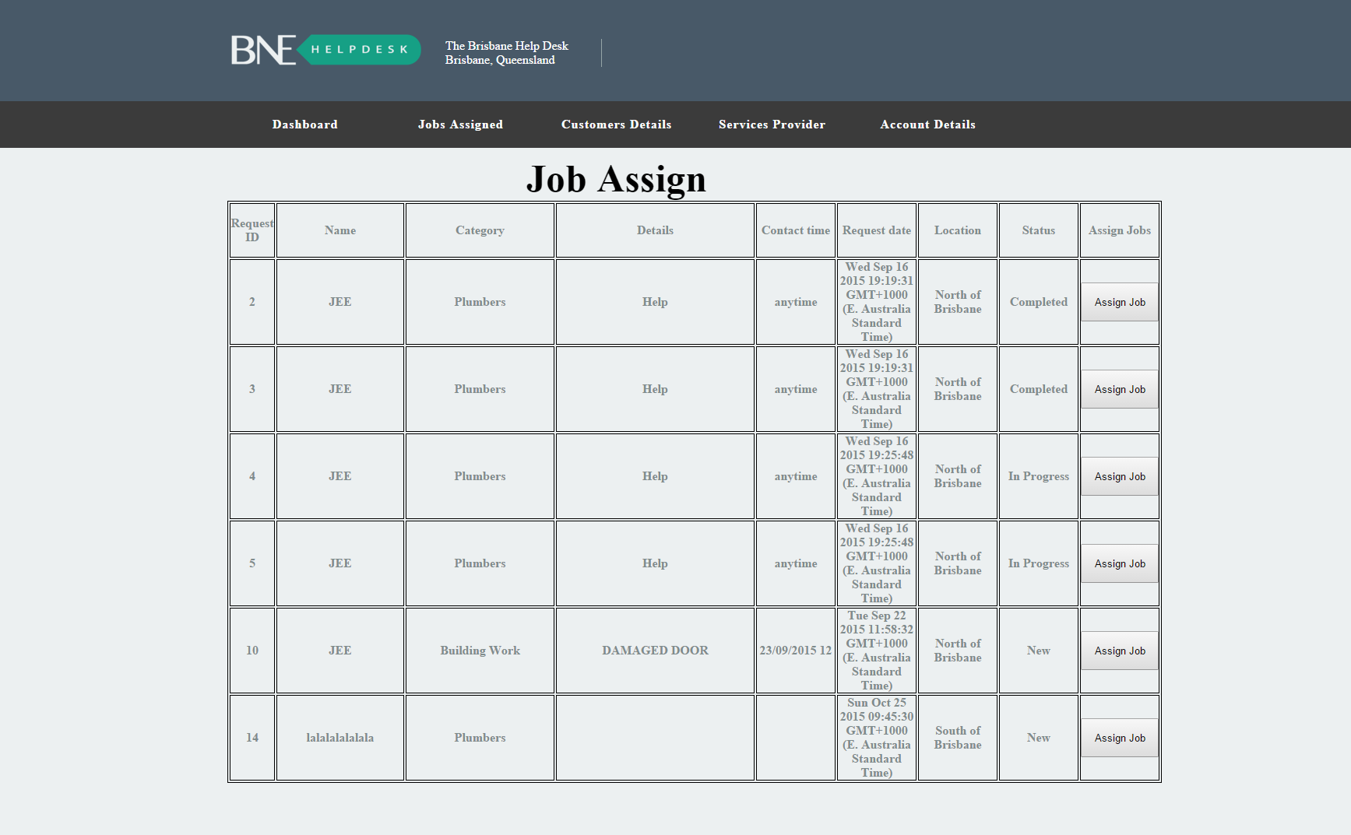
Sprint 4: Story S45 ‘One request one staff’

Slide 26
Burndown Chart

Slide 27
Now, we will show you our website. Thank you for watching.

